Slide 1
Adult Income
Census Data
Data Source: https://www.kaggle.com/datasets/wenruliu/adult-income-dataset 1996

Slide 2
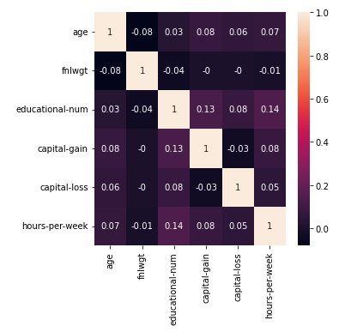
Correlations Among Columns
Please note that the strongest correlations are the ones closest to 1, either in the negative or positive side.
The the more significant correlations are between the following columns.
Years of Education and hours per week
Years of Education and capital gain

Slide 3
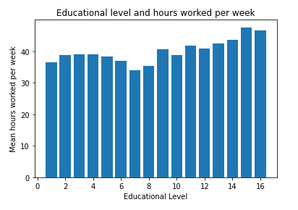
More educated people worked more hours, on average.

Slide 4
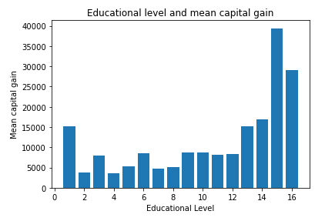
More educated people earned more capital gain, on average.

Slide 5
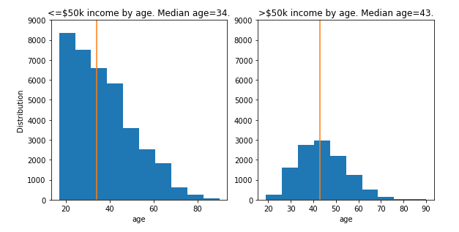
More younger people are in the <=50k income category.
.
There are a lot less people in the >50k income category.
<= 50k | 37155
>50k | 11687

Slide 6
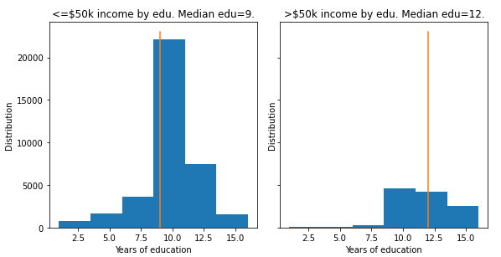
Those earning >50k have gone to school on average 3 more years than those earning <50k.

Slide 7
Gender gap
Income by gender
Education by gender
 | Income <= 50k in % | Income > 50k in %
Male | 70% | 30%
Female | 89% | 11%
 | Mean years of Education | Median years of Education
Male | 10.04 | 10.0
Female | 10.09 | 10.0

Slide 8
Suggested future project
It would be interesting to compare this census data to the 2020 census data.

